Slide 1
Database & MongoDB

Slide 2
Day 1 - Topics
1. Introduction to RDBMS
2. Basics of SQL Queries
3. Subdivisions of SQL Queries
- DML
-DDL
-DQL
4. Aggregate Functions
5. Multiplicity

Slide 3
Introduction To RDBMS
RDBMS stands for Relational Database Management System. RDBMS data is structured in database tables, fields and records. Each RDBMS table consists of database table rows.
Each database table row consists of one or more database table fields. RDBMS store the data into collection of tables, which might be related by common fields (database table columns).
RDBMS also provide relational operators to manipulate the data stored into the database tables.
Most RDBMS use SQL as database querylanguage. The most popular RDBMS are MS SQL Server, DB2, Oracle and MySQL.

Slide 4
Difference Between DBMS & RDBMS
A DBMS has to be persistent, that is it should be accessible when the program created the data ceases to exist or even the application that created the data restarted.
A DBMS also has to provide some uniform methods independent of a specific application for accessing the information that is stored.
RDBMS is a Relational Data Base Management System Relational DBMS. This adds the additional condition that the system supports a tabular structure for the data, with enforced relationships between the tables.
This excludes the databases that don't support a tabular structure or don't enforce relationships between tables

Slide 5
History of SQL
The SQL programming language was first developed in the 1970s by IBM researchers Raymond Boyce and Donald Chamberlin.
The programming language, known then as SEQUEL, was created following the publishing of Edgar Frank Todd's paper, "A Relational Model of Data for Large Shared Data Banks," in 1970.
MySQL
Rather than trying to write an SQL for their own databases, many companies use a database management system that has SQL already built in to it.
Developed and distributed by Oracle, MySQL is one of the most popular SQL database management systems currently available. The software is an open source version, which means it can be downloaded and used for free.

Slide 6
What is SQL?
SQL stands for Structured Query Language. It is used for storing and managing data in relational database management system (RDMS).
It is a standard language for Relational Database System. It enables a user to create, read, update and delete relational databases and tables.
All the RDBMS like MySQL, Informix, Oracle, MS Access and SQL Server use SQL as their standard database language.
SQL allows users to query the database in a number of ways, using English-like statements.

Slide 7
SQL follows the following rules:
Structure query language is not case sensitive. Generally, keywords of SQL are written in uppercase.
Statements of SQL are dependent on text lines. We can use a single SQL statement on one or multiple text line.
Using the SQL statements, you can perform most of the actions in a database.
SQL depends on tuple relational calculus and relational algebra.

Slide 8
SQL process:
When an SQL command is executing for any RDBMS, then the system figure out the best way to carry out the request and the SQL engine determines that how to interpret the task.
In the process, various components are included. These components can be optimization Engine, Query engine, Query dispatcher, classic, etc.
All the non-SQL queries are handled by the classic query engine, but SQL query engine won't handle logical files.

Slide 9
SQL Commands
SQL commands are instructions. It is used to communicate with the database. It is also used to perform specific tasks, functions, and queries of data.
SQL can perform various tasks like create a table, add data to tables, drop the table, modify the table, set permission for users.
Types of SQL Commands
There are five types of SQL commands: DDL, DML, DCL, TCL, and DQL.

Slide 10
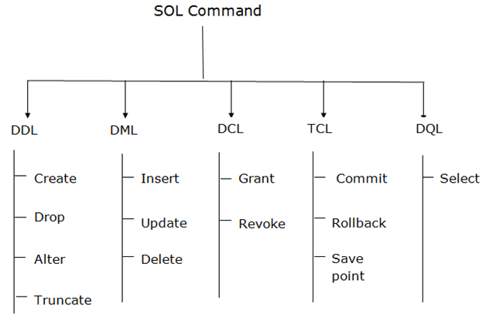

Slide 11
1. Data Definition Language (DDL)
DDL changes the structure of the table like creating a table, deleting a table, altering a table, etc.
All the command of DDL are auto-committed that means it permanently save all the changes in the database.
Here are some commands that come under DDL:
CREATE
ALTER
DROP
TRUNCATE

Slide 12
1. CREATE :
It is used to create a new table in the database.
- Syntax:
CREATE TABLE TABLE_NAME (COLUMN_NAME DATATYPES[,....]);
- Example:
CREATE TABLE EMPLOYEE(Name VARCHAR2(20), Email VARCHAR2(100), DOB DATE);
2. DROP:
It is used to delete both the structure and record stored in the table.
- Syntax:
DROP TABLE ;
- Example:
DROP TABLE EMPLOYEE;

Slide 13
3. ALTER:
It is used to alter the structure of the database. This change could be either to modify the characteristics of an existing attribute or probably to add a new attribute.
- Syntax:
To add a new column in the table:
ALTER TABLE table_name ADD column_name COLUMN-definition;
To modify existing column in the table:
ALTER TABLE MODIFY(COLUMN DEFINITION....);
- Example:
ALTER TABLE STU_DETAILS ADD(ADDRESS VARCHAR2(20));
ALTER TABLE STU_DETAILS MODIFY (NAME VARCHAR2(20));

Slide 14
4. TRUNCATE:
It is used to delete all the rows from the table and free the space containing the table.
- Syntax:
TRUNCATE TABLE table_name;
- Example:
TRUNCATE TABLE EMPLOYEE;

Slide 15
2. Data Manipulation Language
DML commands are used to modify the database. It is responsible for all form of changes in the database.
The command of DML is not auto-committed that means it can't permanently save all the changes in the database. They can be rollback.
Here are some commands that come under DML:
INSERT
UPDATE
DELETE

Slide 16
1. INSERT:
The INSERT statement is a SQL query. It is used to insert data into the row of a table.
- Syntax:
INSERT INTO TABLE_NAME
(col1, col2, col3,.... col N)
VALUES (value1, value2, value3, .... valueN);
Or
INSERT INTO TABLE_NAME
VALUES (value1, value2, value3, .... valueN);
- For Example:
INSERT INTO javatpoint (Author, Subject) VALUES ("Sonoo", "DBMS");

Slide 17
2. UPDATE:
This command is used to update or modify the value of a column in the table.
- Syntax:
UPDATE table_name SET [column_name1= value1,...column_nameN = valueN] [WHERE CONDITION]
- For Example:
UPDATE students
SET User_Name = 'Sonoo'
WHERE Student_Id = '3'
3.DELETE:
It is used to remove one or more row from a table.
- Syntax:
DELETE FROM table_name [WHERE condition];
- For Example:
DELETE FROM javatpoint
WHERE Author="Sonoo";

Slide 18
3. Data Query Language
DQL is used to fetch the data from the database.
It uses only one command:
- SELECT
SELECT:
This is the same as the projection operation of relational algebra. It is used to select the attribute based on the condition described by WHERE clause.

Slide 19
- Syntax:
SELECT expressions
FROM TABLES
WHERE conditions;
- For Example:
SELECT emp_name
FROM employee
WHERE age > 20;

Slide 20
Basic SQL Queries
SQL is followed by a unique set of rules and guidelines called Syntax. This tutorial gives you a quick start with SQL by listing all the basic SQL Syntax.
All the SQL statements start with any of the keywords like SELECT, INSERT, UPDATE, DELETE, ALTER, DROP, CREATE, USE, SHOW and all the statements end with a semicolon (;).
The most important point to be noted here is that SQL is case insensitive, which means SELECT and select have same meaning in SQL statements. Whereas, MySQL makes difference in table names.
So, if you are working with MySQL, then you need to give table names as they exist in the database.

Slide 21
SQL Commands
These are the some important SQL command:
SELECT: It extracts data from a database.
UPDATE: It updates data in database.
DELETE: It deletes data from database.
CREATE TABLE: It creates a new table.
ALTER TABLE: It is used to modify the table.
DROP TABLE: It deletes a table.
CREATE DATABASE: It creates a new database.
ALTER DATABASE: It is used to modify a database.
INSERT INTO: It inserts new data into a database.
CREATE INDEX: It is used to create an index (search key).
DROP INDEX: It deletes an index.

Slide 22
Syntax:
SQL SELECT Statement
SELECT column1, column2....columnN
FROM table_name;
SQL DISTINCT Clause
SELECT DISTINCT column1, column2....columnN
FROM table_name;
SQL WHERE Clause
SELECT column1, column2....columnN
FROM table_name
WHERE CONDITION;

Slide 23
SQL AND/OR Clause
SELECT column1, column2....columnN
FROM table_name
WHERE CONDITION-1 {AND|OR} CONDITION-2;
SQL IN Clause
SELECT column1, column2....columnN
FROM table_name
WHERE column_name IN (val-1, val-2,...val-N);
SQL BETWEEN Clause
SELECT column1, column2....columnN
FROM table_name
WHERE column_name BETWEEN val-1 AND val-2;

Slide 24
SQL LIKE Clause
SELECT column1, column2....columnN
FROM table_name
WHERE column_name LIKE { PATTERN };
SQL ORDER BY Clause
SELECT column1, column2....columnN
FROM table_name
WHERE CONDITION
ORDER BY column_name {ASC|DESC};
SQL GROUP BY Clause
SELECT SUM(column_name)
FROM table_name
WHERE CONDITION
GROUP BY column_name;

Slide 25
SQL COUNT Clause
SELECT COUNT(column_name)
FROM table_name
WHERE CONDITION;
SQL CREATE TABLE Statement
CREATE TABLE table_name(
column1 datatype,
column2 datatype,
column3 datatype,
.....
columnN datatype,
PRIMARY KEY( one or more columns )
);

Slide 26
SQL DROP TABLE Statement
DROP TABLE table_name;
SQL CREATE INDEX Statement
CREATE UNIQUE INDEX index_name
ON table_name ( column1, column2,...columnN);
SQL DROP INDEX Statement
ALTER TABLE table_name
DROP INDEX index_name;
SQL ALTER TABLE Statement
ALTER TABLE table_name {ADD|DROP|MODIFY} column_name {data_ype};
SQL ALTER TABLE Statement (Rename)
ALTER TABLE table_name RENAME TO new_table_name;

Slide 27
SQL INSERT INTO Statement
INSERT INTO table_name( column1, column2....columnN)
VALUES ( value1, value2....valueN);
SQL UPDATE Statement
UPDATE table_name
SET column1 = value1, column2 = value2....columnN=valueN
[ WHERE CONDITION ];
SQL DELETE Statement
DELETE FROM table_name
WHERE {CONDITION};
SQL CREATE DATABASE Statement
CREATE DATABASE database_name;
SQL DROP DATABASE Statement
DROP DATABASE database_name;

Slide 28
Aggregate Functions
Aggregate functions are the functions that take a collection of values as input and return a single value. SQL offers five built-in aggregate functions.
1. Average : AVG
2. Minimum : MIN
3. Maximum : MAX
4. Total : SUM
5. Count : COUNT

Slide 29
These functions operate on a single column of a table and return a single value.
COUNT, MIN and MAX apply to both numeric and non-numeric fields, but SUM and AVG may be used on numeric fields only.
Apart from COUNT(*), each function eliminates nulls first and operates only on the remaining non-null values.
If we want to eliminate duplicates before the function is applied, we use the keyword DISTINCT before the column name in the function.
The keyword ALL can be used if we do not want to eliminate the duplicates.
ALL is assumed if nothing is specified. DISTINCT has no effect on MIN and MAX functions.
It may effect on the result of SUM or AVG. It is important to note that an aggregate function can be used only in SELECT list and in the HAVING clause. It is incorrect to use it elsewhere.

Slide 30
Avg Function :
avg function computes the column's average value. The input to avg must be a collection of numbers.
- Example :
Find the average balance
SQL> select avg (balance)
from account;
This aggregate function can also be applied to a group of set of tuples using group by clause
- Example :
Find the average balance at each branch
SQL> select branch_name, avg (balance)
from account
group by branch_name;

Slide 31
2. Min and Max Functions :
min and max return the minimum and maximum values for the specified column.
- Example :
Find the minimum and maximum values of balance.
Select max (balance) min (balance) from account
3. Sum Function :
sum function computes the column's total value. Input to this function must be a collection of numbers.

Slide 32
4. Count Function :
count function counts the number of rows. There are two forms of count.
count (*) - which counts all the rows in a table that satisfy any specified criteria.
count (column_name) - which counts all rows in a table that have a non-null value for column_name and satisfy the specified criteria.
5. NULL Values :
SQL allows the use of null values to indicate absence of information about the value of an attribute.
We can use the special keyword NULL in a predicate to test for a null value.

Slide 33
- Example :
SQL> select loan_no
from loan
where amount is NULL;
The predicate NOT NULL tests for the absence of null values.
The use of a NULL value in arithmetic and comparison operations causes several complications. The result of an arithmetic expressions is NULL if any of the input values is NULL. The result of any comparison involving a NULL value can be thought of as being false.
In general, aggregate functions treat nulls using the following rule : All aggregate functions except count (*) ignore NULL values in their input collection

Slide 34
Multiplicity
In relational database terminology cardinality concerns tables, i.e. where, quoting from Cardinality (data modeling) , it is important to understand the “cardinality of a given table in relation to another.” Therefore cardinality is measured in terms of the types of relationships employed to relate tables, one-to-many, many-to-many, one-to-one and many-to-one.
In UML the term equivalent concept of association is used to describe the way in which two classes are related to each other. We use the term multiplicity of the association to describe this.

Slide 35
1. One-to-one:
Each entity instance is related to a single instance of another entity. For example, to model a physical warehouse in which each storage bin contains a single widget, StorageBin and Widget would have a one-to-one relationship.
2. One-to-many:
An entity instance can be related to multiple instances of the other entities.
A sales order, for example, can have multiple line items. In the order application, Order would have a one-to-many relationship with LineItem.

Slide 36
3. Many-to-one:
Multiple instances of an entity can be related to a single instance of the other entity.
This multiplicity is the opposite of a one-to-many relationship. In the example just mentioned, from the perspective of LineItem the relationship to Order is many-to-one.
4. Many-to-many:
The entity instances can be related to multiple instances of each other. For example, in college each course has many students, and every student may take several courses.
Therefore, in an enrollment application, Course and Student would have a many-to-many relationship.

Slide 37
DBMS Installation Steps
Developer default: If you want to create a development machine, you can use this option. It installs the components which are required for application development, e.g., MySQL Server, MySQL Shell, MySQL connectors, MySQL
Server Only: If you want to create a standalone database server with specific components, you can use this option
Full: If you want to install MySQL Server with its all components, then you can use this option
Custom: If your requirements are limited to the few components, you can use this option
Link : https://www.sqlshack.com/how-to-install-mysql-database-server-8-0-19-on-windows-10/

Slide 38
Assignments

Slide 39
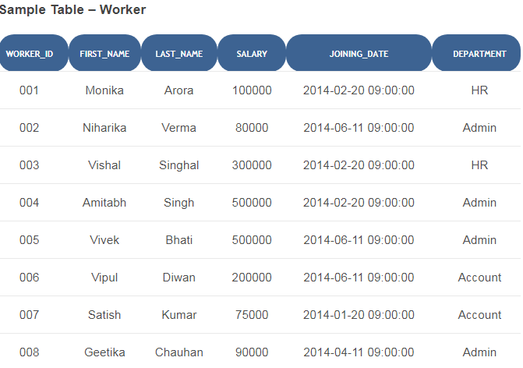

Slide 40
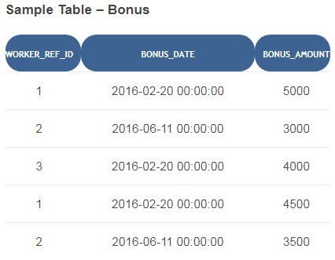

Slide 41
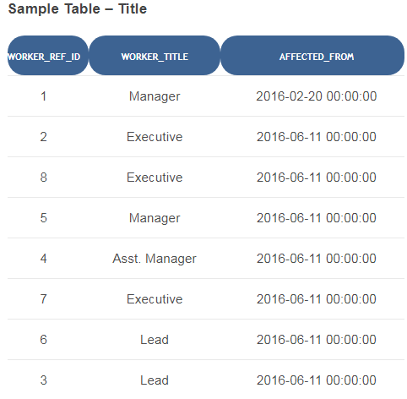

Slide 42
To prepare the sample data, you can run the following queries in your database query executor or on the SQL command line.
We’ve tested them with MySQL Server 5.7 and MySQL Workbench 6.3.8 query browser.
You can also download these Softwares and install them to carry on the SQL exercise.
SQL Script to Seed Sample Data Follows

Slide 43
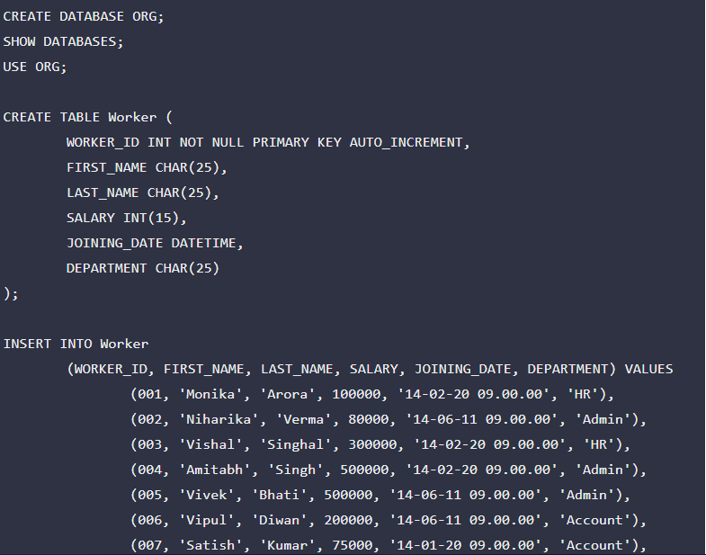

Slide 44
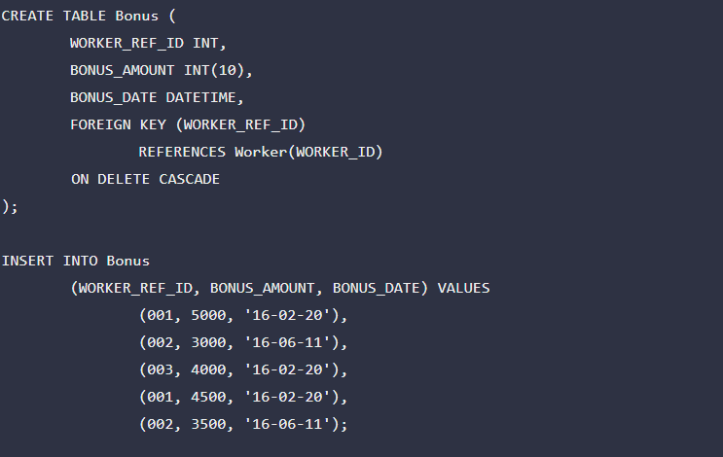

Slide 45
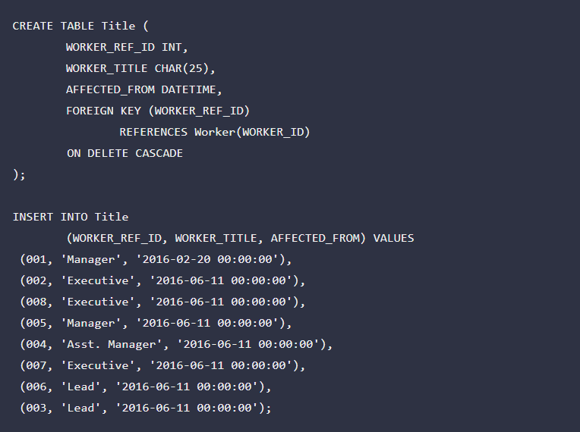

Slide 46
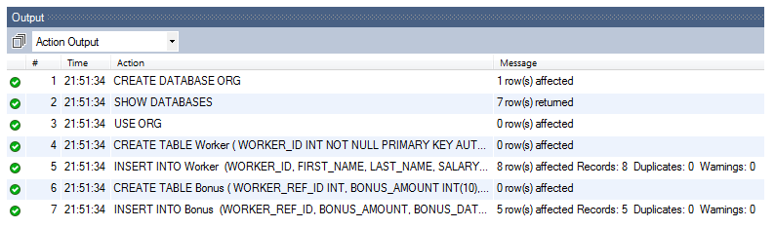
Once above SQL would run, you’ll see a result similar to the one attached below.

Slide 47
SQL Query Questions for Practice
Q-1. Write an SQL query to fetch “FIRST_NAME” from Worker table using the alias name as <WORKER_NAME>.
Q-2. Write an SQL query to fetch “FIRST_NAME” from Worker table in upper case.
Q-3. Write an SQL query to fetch unique values of DEPARTMENT from Worker table.
Q-4. Write an SQL query to print the first three characters of FIRST_NAME from Worker table.
Q-5. Write an SQL query to find the position of the alphabet (‘a’) in the first name column ‘Amitabh’ from Worker table.

Slide 48
Q-6. Write an SQL query to print the FIRST_NAME from Worker table after removing white spaces from the right side.
Q-7. Write an SQL query to print the DEPARTMENT from Worker table after removing white spaces from the left side.
Q-8. Write an SQL query that fetches the unique values of DEPARTMENT from Worker table and prints its length.
Q-9. Write an SQL query to print the FIRST_NAME from Worker table after replacing ‘a’ with ‘A’.
Q-10. Write an SQL query to print the FIRST_NAME and LAST_NAME from Worker table into a single column COMPLETE_NAME. A space char should separate them.

Slide 49
Q-11. Write an SQL query to print all Worker details from the Worker table order by FIRST_NAME Ascending.
Q-12. Write an SQL query to print all Worker details from the Worker table order by FIRST_NAME Ascending and DEPARTMENT Descending.
Q-13. Write an SQL query to print details for Workers with the first name as “Vipul” and “Satish” from Worker table.
Q-14. Write an SQL query to print details of workers excluding first names, “Vipul” and “Satish” from Worker table.
Q-15. Write an SQL query to print details of Workers with DEPARTMENT name as “Admin”.

Slide 50
Q-16. Write an SQL query to print details of the Workers whose FIRST_NAME contains ‘a’.
Q-17. Write an SQL query to print details of the Workers whose FIRST_NAME ends with ‘a’.
Q-18. Write an SQL query to print details of the Workers whose FIRST_NAME ends with ‘h’ and contains six alphabets.
Q-19. Write an SQL query to print details of the Workers whose SALARY lies between 100000 and 500000.
Q-20. Write an SQL query to print details of the Workers who have joined in Feb’2014.

Slide 51
Q-21. Write an SQL query to fetch the count of employees working in the department ‘Admin’.
Q-22. Write an SQL query to fetch worker names with salaries >= 50000 and <= 100000.
Q-23. Write an SQL query to fetch the no. of workers for each department in the descending order.
Q-24. Write an SQL query to print details of the Workers who are also Managers.
Q-25. Write an SQL query to fetch duplicate records having matching data in some fields of a table.

Slide 52
Q-26. Write an SQL query to show only odd rows from a table.
Q-27. Write an SQL query to show only even rows from a table.
Q-28. Write an SQL query to clone a new table from another table.
Q-29. Write an SQL query to fetch intersecting records of two tables.
Q-30. Write an SQL query to show records from one table that another table does not have.
Q-31. Write an SQL query to show the current date and time.
Q-32. Write an SQL query to show the top n (say 10) records of a table.
Q-33. Write an SQL query to determine the nth (say n=5) highest salary from a table

Slide 53
Q-34. Write an SQL query to determine the 5th highest salary without using TOP or limit method.
Q-35. Write an SQL query to fetch the list of employees with the same salary.
Q-36. Write an SQL query to show the second highest salary from a table.
Q-37. Write an SQL query to show one row twice in results from a table.
Q-38. Write an SQL query to fetch intersecting records of two tables.
Q-39. Write an SQL query to fetch the first 50% records from a table.
Q-40. Write an SQL query to fetch the departments that have less than five people in it.

Slide 54
Q-41. Write an SQL query to show all departments along with the number of people in there.
Q-42. Write an SQL query to show the last record from a table.
Q-43. Write an SQL query to fetch the first row of a table.
Q-44. Write an SQL query to fetch the last five records from a table.
Q-45. Write an SQL query to print the name of employees having the highest salary in each department.
Q-46. Write an SQL query to fetch three max salaries from a table.
Q-47. Write an SQL query to fetch three min salaries from a table.
Q-48. Write an SQL query to fetch nth max salaries from a table.

Slide 55
Q-49. Write an SQL query to fetch departments along with the total salaries paid for each of them.
Q-50. Write an SQL query to fetch the names of workers who earn the highest salary.
***********************************************

Slide 56
END OF SESSION
Q & A

